Slide 1
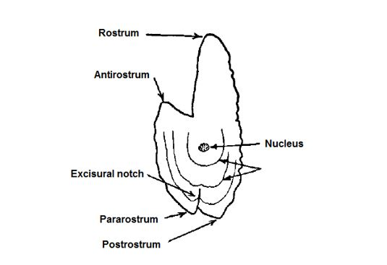
Age determination of Atlantic Herring in the Gulf region

Slide 2
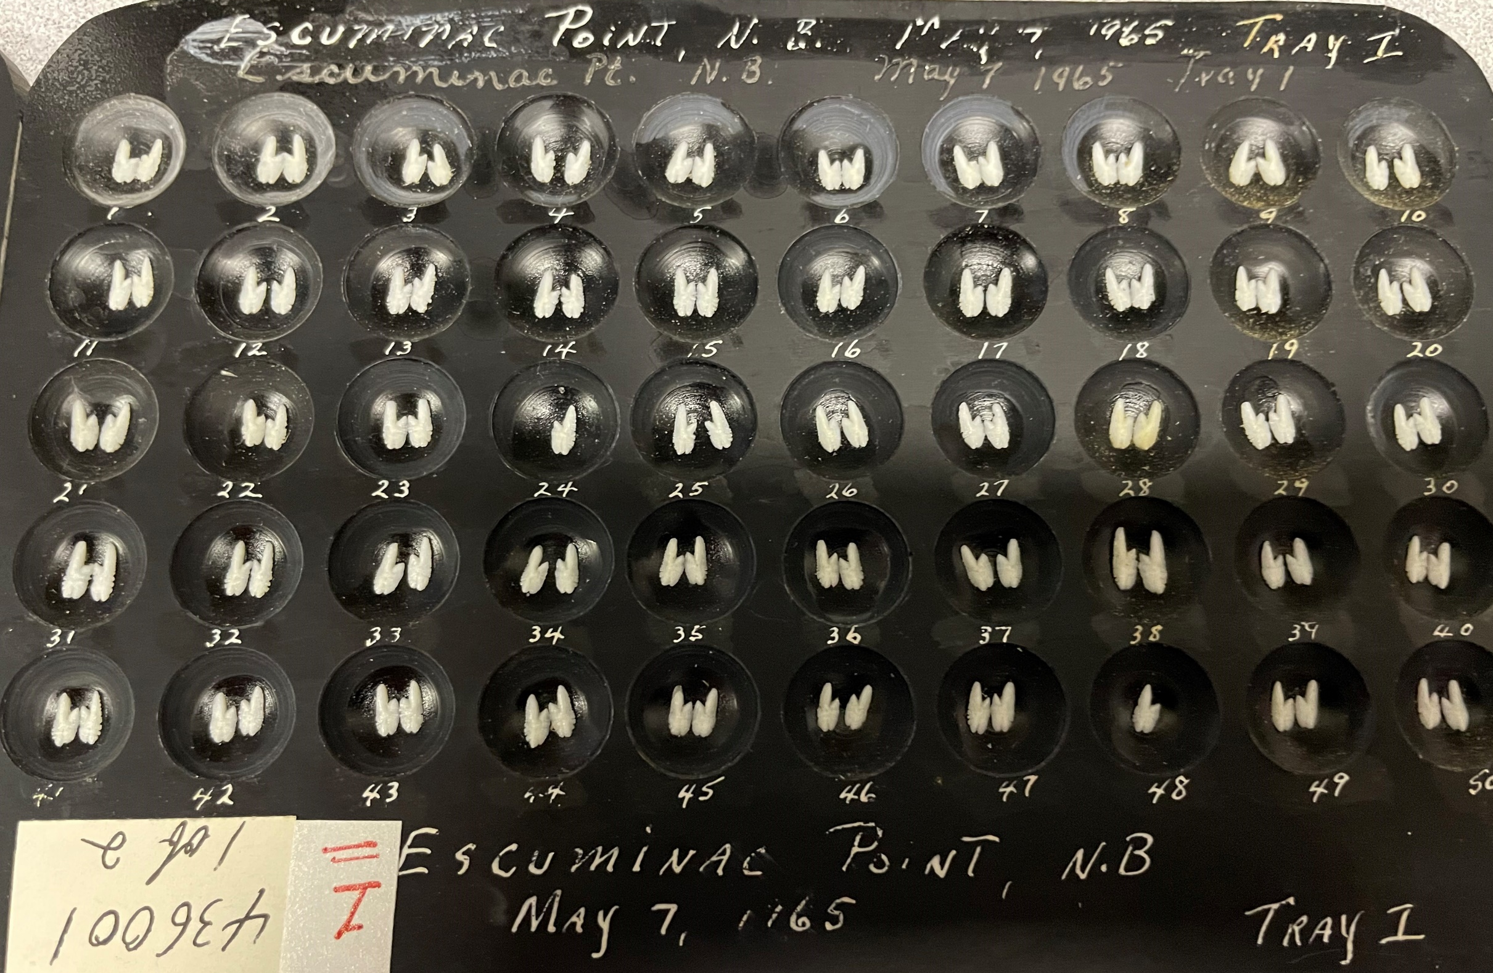
What we have…
One of our largest collections of otoliths dating back to 1965
Collected from port sampling programs, experimental net fishery and surveys (Annual Trawl Survey & Acoustic)
We process and age ~ 3500/year
Collection consists of whole otoliths embedded in acrylic plates
Digital images since 2009
A digital Reference collection of 210 Otoliths

Slide 3
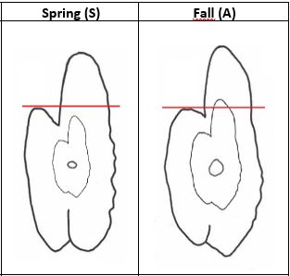
Spring vs. Fall Spawners
Determining if the fish is a spring or fall spawner is the first and a very important step
April – June = Spring
August – November = Fall
July = We include in the fall spawning period
First visible ring (annulus) – will be shorter than the antirostrum in spring fish.
It is this feature that is primarily used to differentiate between spring and fall spawners (other characteristics below only serve to compliment this)
This feature can trump the date the fish was caught
Date (month) of capture, GSI (Gonadosomatic Index – gonad weight in relation to total body weight) and maturity stage could be used later to reclassify the spawning component given by the reader

Slide 4
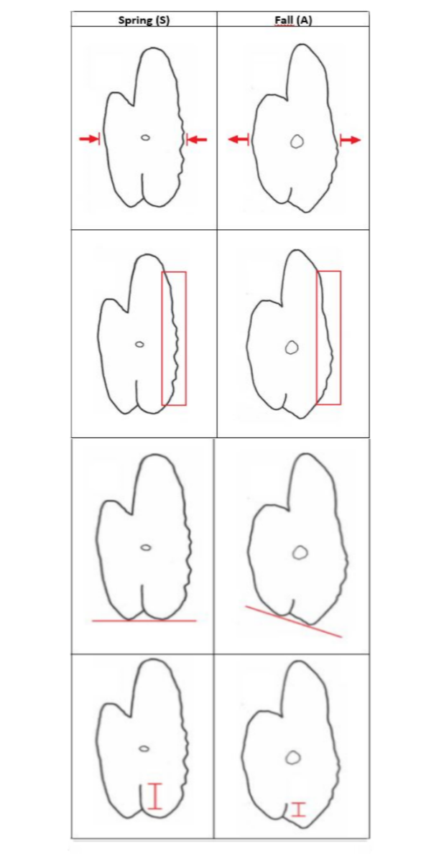
Spring vs. Fall Spawners
Secondary characteristics that could help differentiate are:
The size and shape of spring fish are usually thin, elongated and compressed laterally
The dorsal edge of the otolith is also usually more serrated than in fall fish
Pararostrum and Postrostrum – In spring fish these tend to be the same length (in fall fish the postrostrum is almost twice as long as the pararostrum)
Excisural Notch – In spring fish the fissure between the pararostrum and the postrostrum is clearly defined (both deep and long) – might only be noticeable when comparing spring and fall fish.

Slide 5
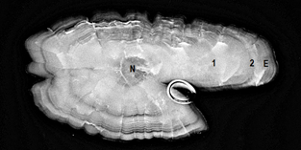
Reading the otolith
After embedding the otoliths, taking the pictures and running enhancements, they ready for reading by experienced ager
Readers should be calibrated with the reference collection before beginning the years otoliths.
Identify which group it belongs to: Spring Spawners or Fall Spawners by looking at the first annulus
Age the otolith “blind” – no length information
Count the dark or translucent annuli
For fish caught in the fall (August-November) count only the dark or translucent (winter growth) rings
For fish caught in the spring (April-June) the last opaque or white (summer growth) zone must be added to the age (+1)
For fish caught in the summer (July), it is at the discretion of the ager to decide if the last dark ring is the age or if the opaque zone should be added.
Spring spawner, N is nucleus; 1 is the first annulus; 2 is the 2nd annulus; and E is edge, the zone of unfinished yearly growth. Age=(2+1)3

Slide 6
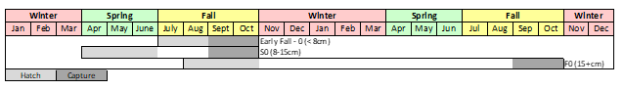
Tips and “Checks”
Age = 0 Length 12.9cm Spring Spawner
Both otoliths should be read, and a count taken along each axis but usually clearest along the rostrum
A true annuli is dark and defined and can be followed around the entire otolith
Sometimes a check after the first spawning event (between 3-4 years)
A general rule of thumb is to count all rings after 8 years
For juveniles aged 0 (no rings on the otoliths) the length should be used to determine spawning component

Slide 7
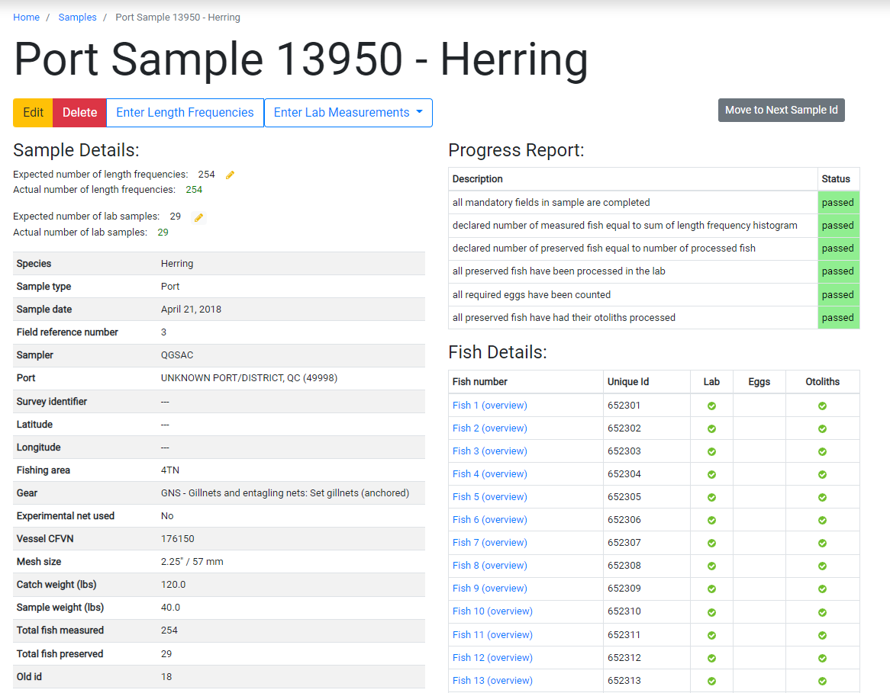

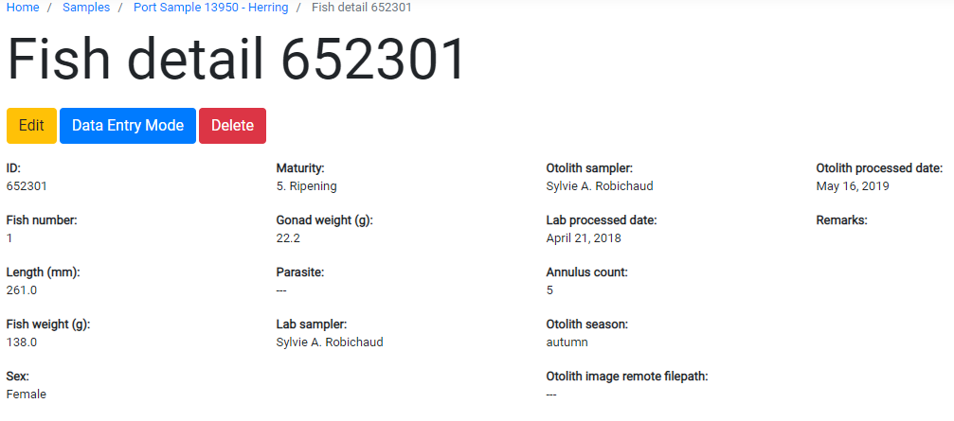
The age information is added to DM apps database where it is linked with the detailed information of the sample and fish details.

